Slide 1
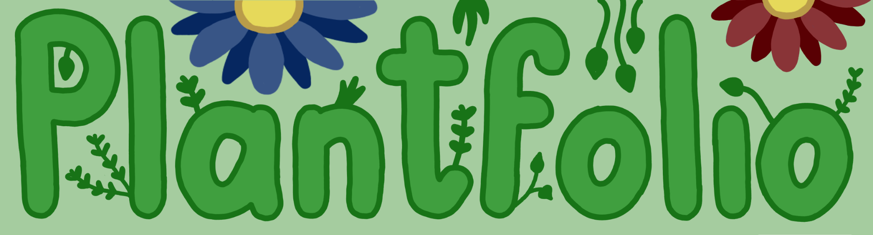
Group 10
Freya van Apeldoorn, Wybe Mijnendonckx, Owen Moon, Denzel Träger, Yiri Zwart
TA: Rok Štular
Prof. : Ivar de Bruin, Fenia Availoglou
Notes:
Owen

Slide 2

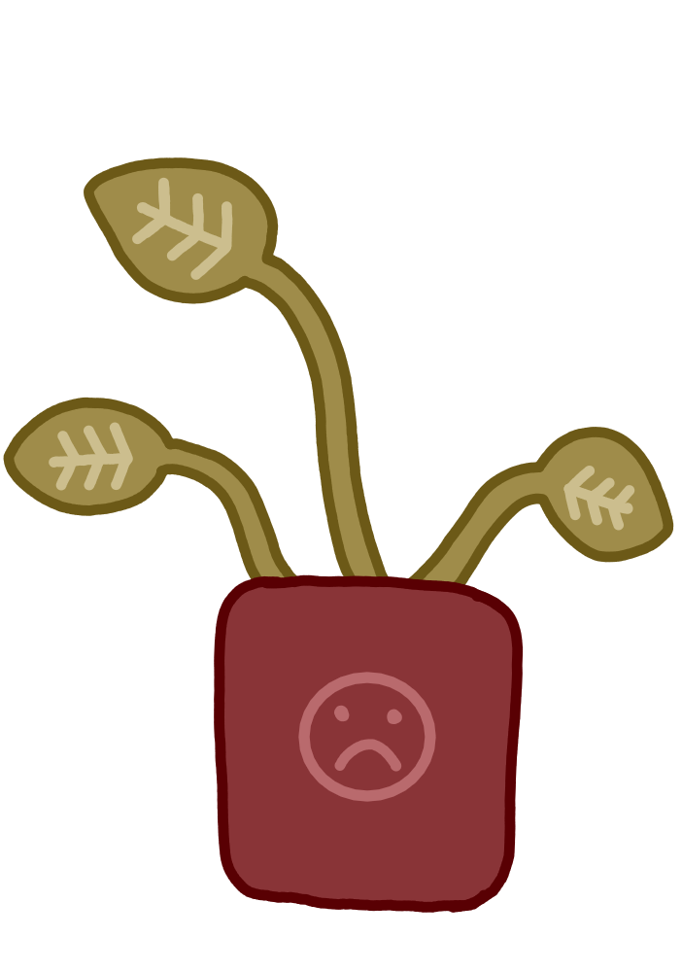
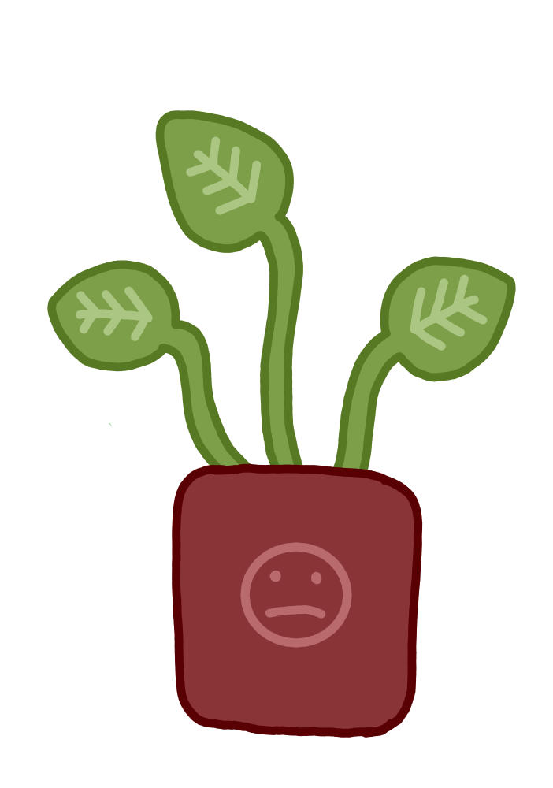
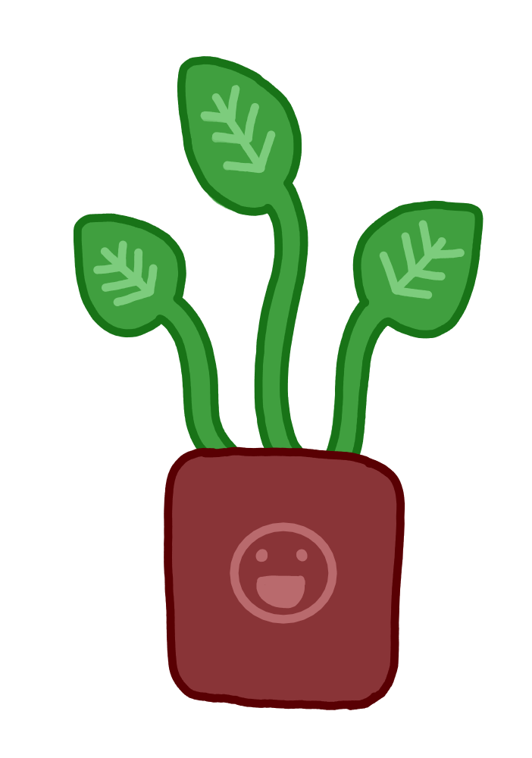
Progress
Must-haves: All finished
Should-haves: All but 2 finished
Could-haves: 1 finished
Notes:
Owen

Slide 3

Demo
Notes:
Denzel

Slide 4
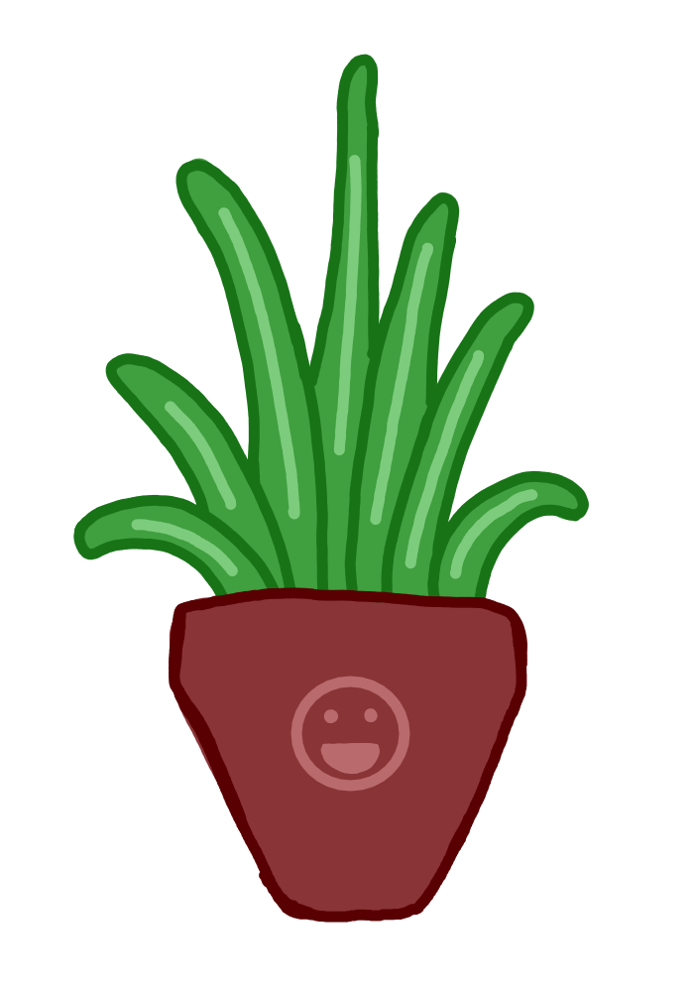
Reflection - what we improved
TA meetings were less passive after midterm
→ Less questions and more reporting
Issues structured better and more specific
More tests
Workload more balanced
Branch structure less messy
Working more individually
→ Got more work done
Notes:
Wybe

Slide 5
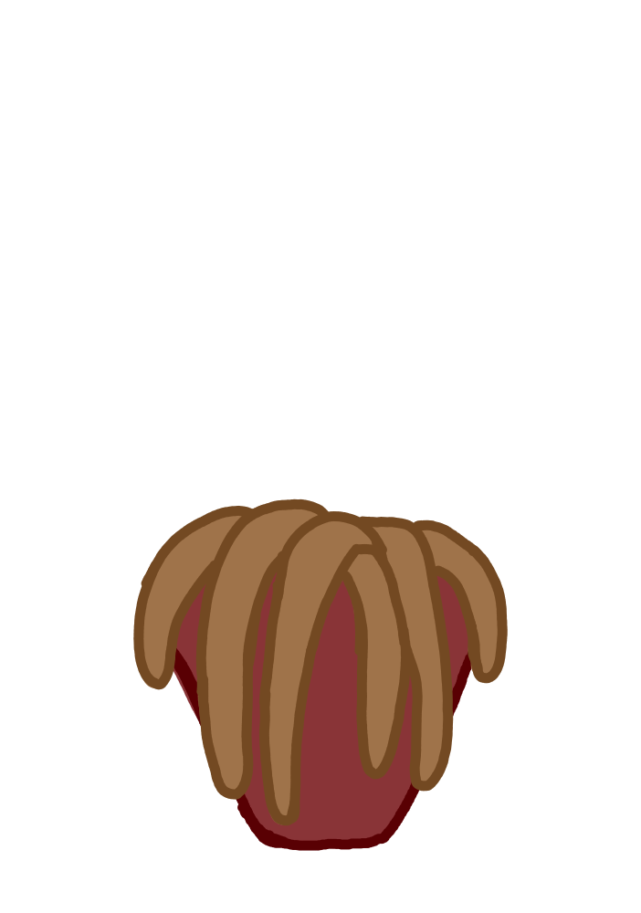
Reflection - what could have been better
Working less individually
→ Communication was more difficult
We didn’t really take use-cases into account
We didn’t use issue weights
We could have had more extensive reviews on merge requests
Notes:
Wybe

Slide 6

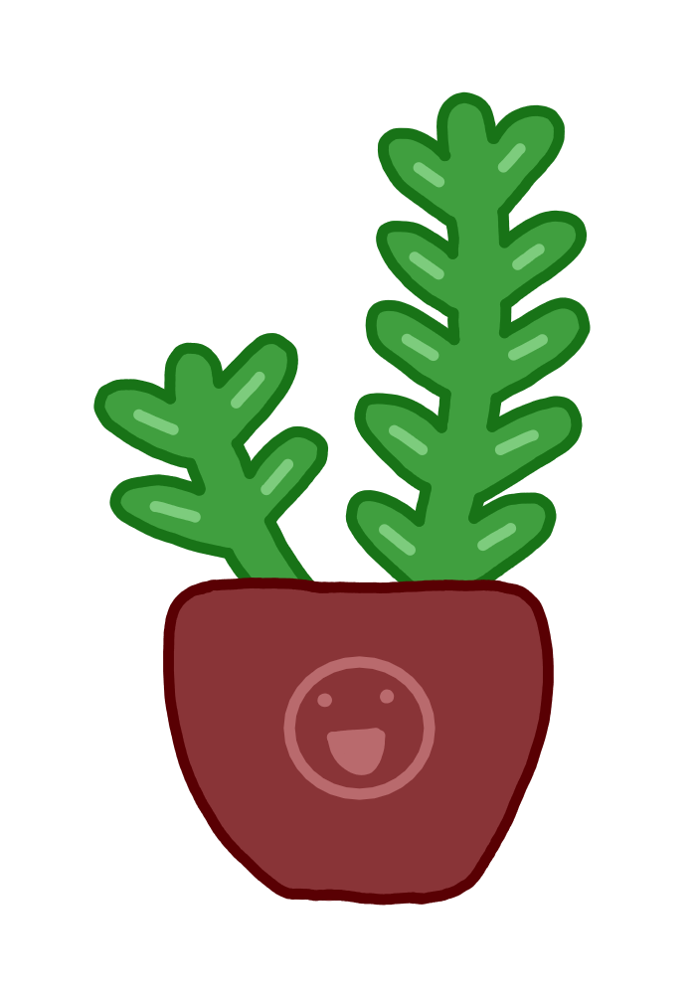
Future development
Implementing a custom map of your house so you can see the spots
→ Makes application more intuitive
Recognizing the plant species by uploading a picture
→ Helps for plants that the user already owns/got as a gift
Help identify sickness and parasites in a plant
→ Helps user keep plants alive
Notes:
Freya

Slide 7
Future development
Improve accuracy of health determination
→ Improves functionality
Improve sunlight conditions/hours determination based on geographic location
→ Also improves accuracy/functionality
Make GUI adapt to window size
→ Improves user experience
Notes:
Freya

Slide 8
Q&A
Notes:
Yiri

